Slide 1
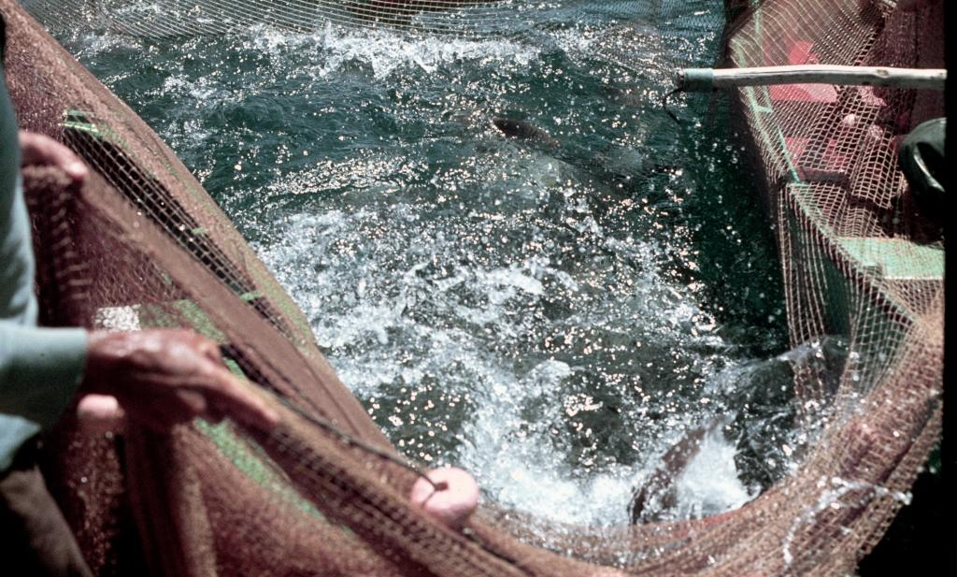
Fisheries management through carbon sequestration would improve climate resilience
Villasante S¹, Prellezo R², Da Rocha JM³
University of Santiago de Compostela¹
AZTI²
University of Vigo (Spain)³

Slide 2
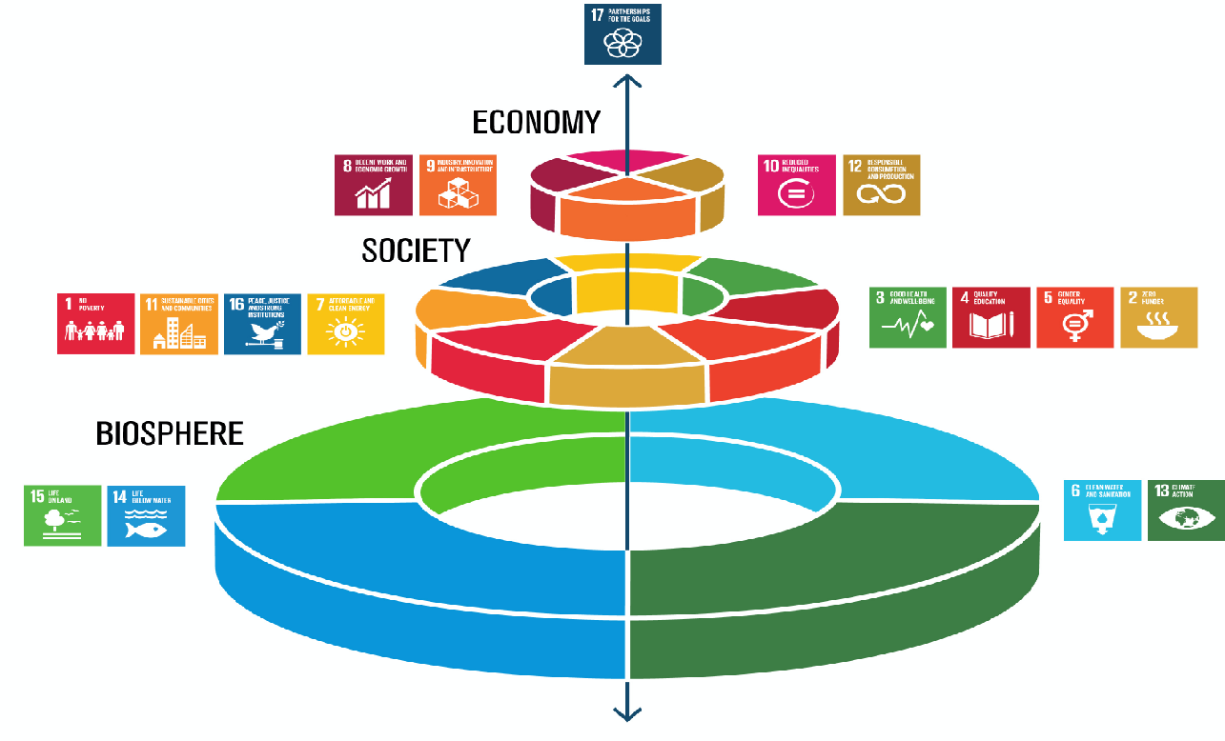
Life on our Planet depends on
healthy oceans
Folke et al. (2016) Ecology and Society

Slide 3
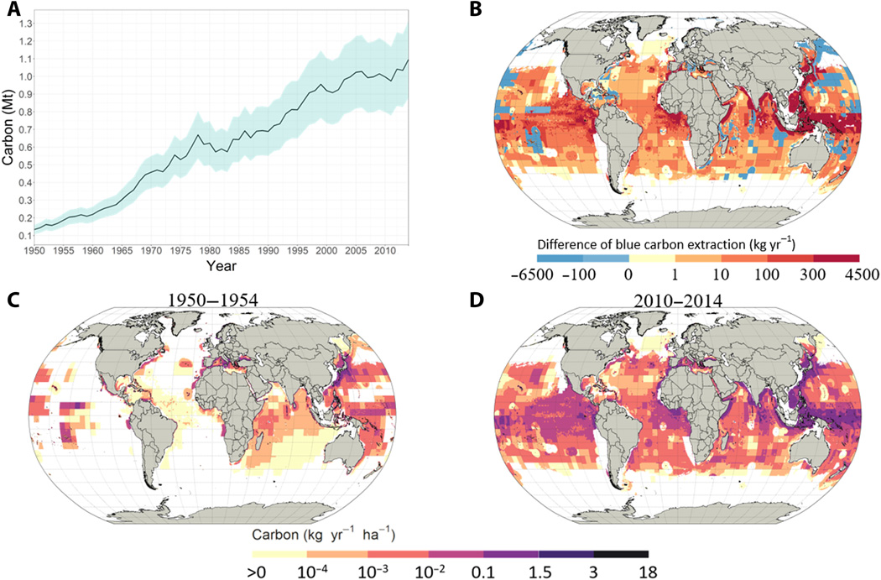
Fishing is preventing blue sequestration
Mariani et al. (2020) Science

Slide 4
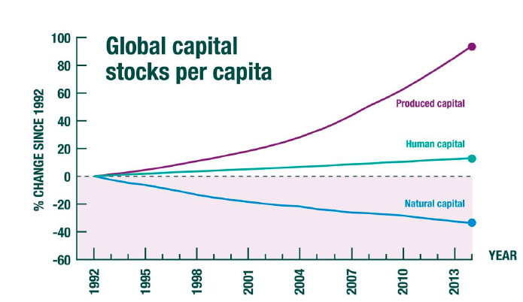
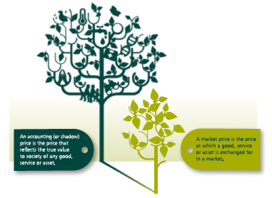
Shadow prices for blue carbon
Dasgupta (2021) The economics of biodiversity: The Dasgupta Review, London.
Managi & Kumar (2018) Inclusive Wealth Report 2018. London

Slide 5
Global CO₂ emissions and Paris Agreement
Paris Agreement provides a robust basis for the use of international markets
The EU emissions trading system is the main EU policy to combat climate change
The EU ETS remains the world’s biggest emission trading market, over ¾ of global carbon trade
A “cap and trade” system:
Total amount of certain greenhouse gases allowed to emit each year
Companies receive/buy emission allowances
European Commission (2021)

Slide 6
The fisheries sector and the carbon markets
Society implicitly assigns carbon emission allowances (“shadow prices”)
Carbon markets to know the social cost of fishing
Estimate the economic value of prevented blue carbon sequestration
Catches from Sea Around Us Database (2010-2016)
FAO Fishing Areas
Small-scale and industrial fisheries
Reducing fishing activities which are socially negative (protein-carbon), even under limitations of existing carbon markets

Slide 7
Blue carbon supply curve for industrial fisheries
Paris Agreement Target 1.5 Cº
Villasante, Prellezo, Da Rocha et al. (2021) In prep.
Notes:
Esto es lo que ocurriria

Slide 8
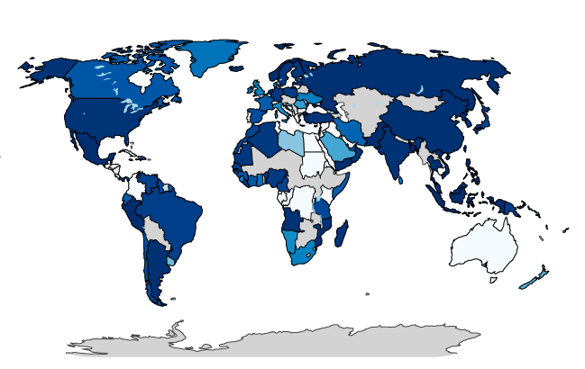
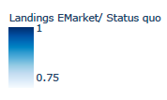
Carbon markets could help reduce overfishing and increase climate resilience
Villasante, Prellezo, Da Rocha et al. (2021) In prep.

Slide 9
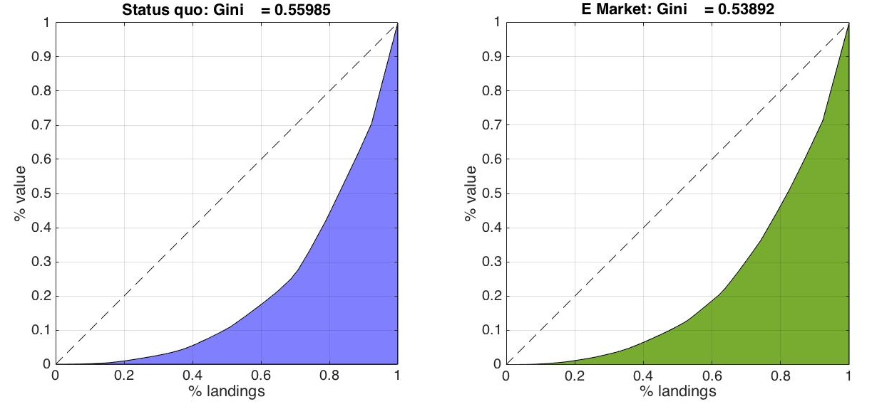
Towards a better distribution of oceans benefits
Villasante, Prellezo, Da Rocha et al. (2021) In prep.

Slide 10
Take home message
Institutional acceptance depends on political decision
Low carbon fishing will increase fish biomass and carbon sequestration => more resilient fish and ocean
More equitable distribution of fishery resources
Portfolio of solutions to reduce overfishing
Non-rivalry with current fisheries management systems (e.g. MPAs)

Slide 11
Thank you
sebastian.villasante@usc.es
@SebVillasante

